Slide 1
Insurance Project
Group Members
01
02
03
04
05
Mr. Shoubhik Paul
Ms. Kalyani Ravindra Deshmukh
Ms. Sakshi Jain
Mr. Aditya Ram
Gaurav Jaiswal

Slide 2
Objectives
Objective
Objective
Objective
Objective
Translate data into actionable insights that guide decision-making at both the corporate and branch levels.Highlight branches that are performing exceptionally well and areas where improvement is needed.
Improve the performance of insurance branches by closely monitoring and analyzing weekly metrics. Regularly track and analyze the weekly performance metrics of various insurance branches.
Analyze factors influencing customer retention and policy renewals.
The main objective is to transform the insurance company into a data-driven organization, enhancing its ability to make informed decisions, optimize branch performance, and continuously improve its strategies and operations.
01
02
03
04

Slide 3
Number of Invoice by Account Executive.
01
Top Open Opportunity
06
02
Yearly Meeting Count
Number of meetings by Account Executive
05
List of KPI’s
03.1
Cross Sell-Target, Achieved, New.
Stage Funnel by Revenue
04
03.2
New-Target, Achieved, New.
03.3
Renewal-Target, Achieved, New.

Slide 4
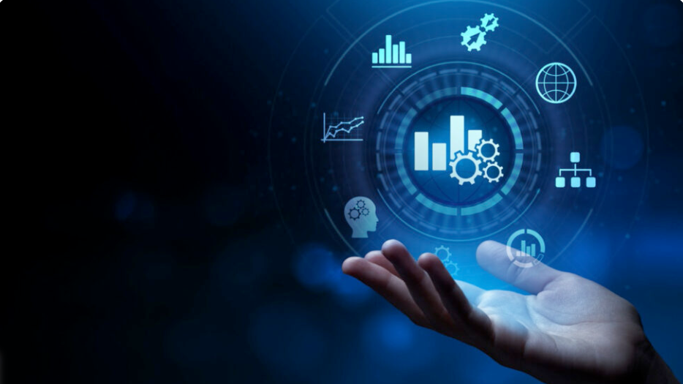



Dashboards
Excel
Tableau
Power BI

Slide 5
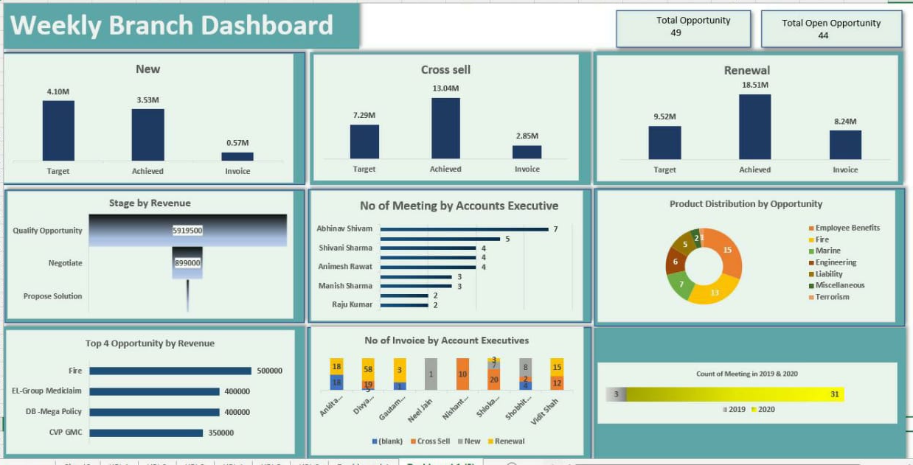
Excel Dashboard

Slide 6
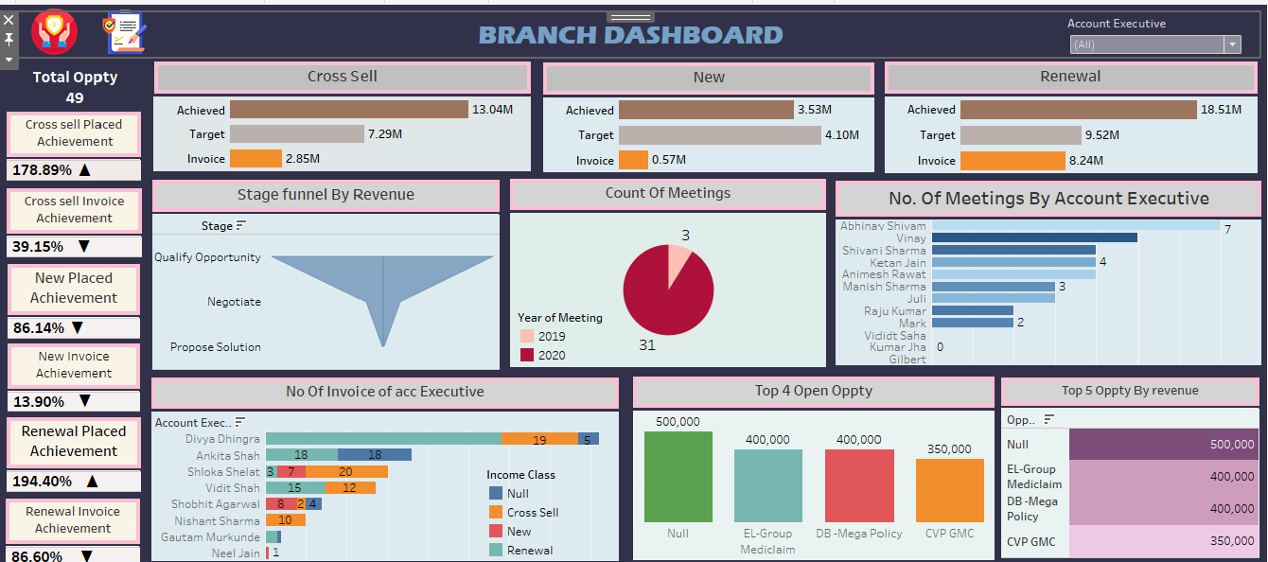
Tableau Dashboard

Slide 7
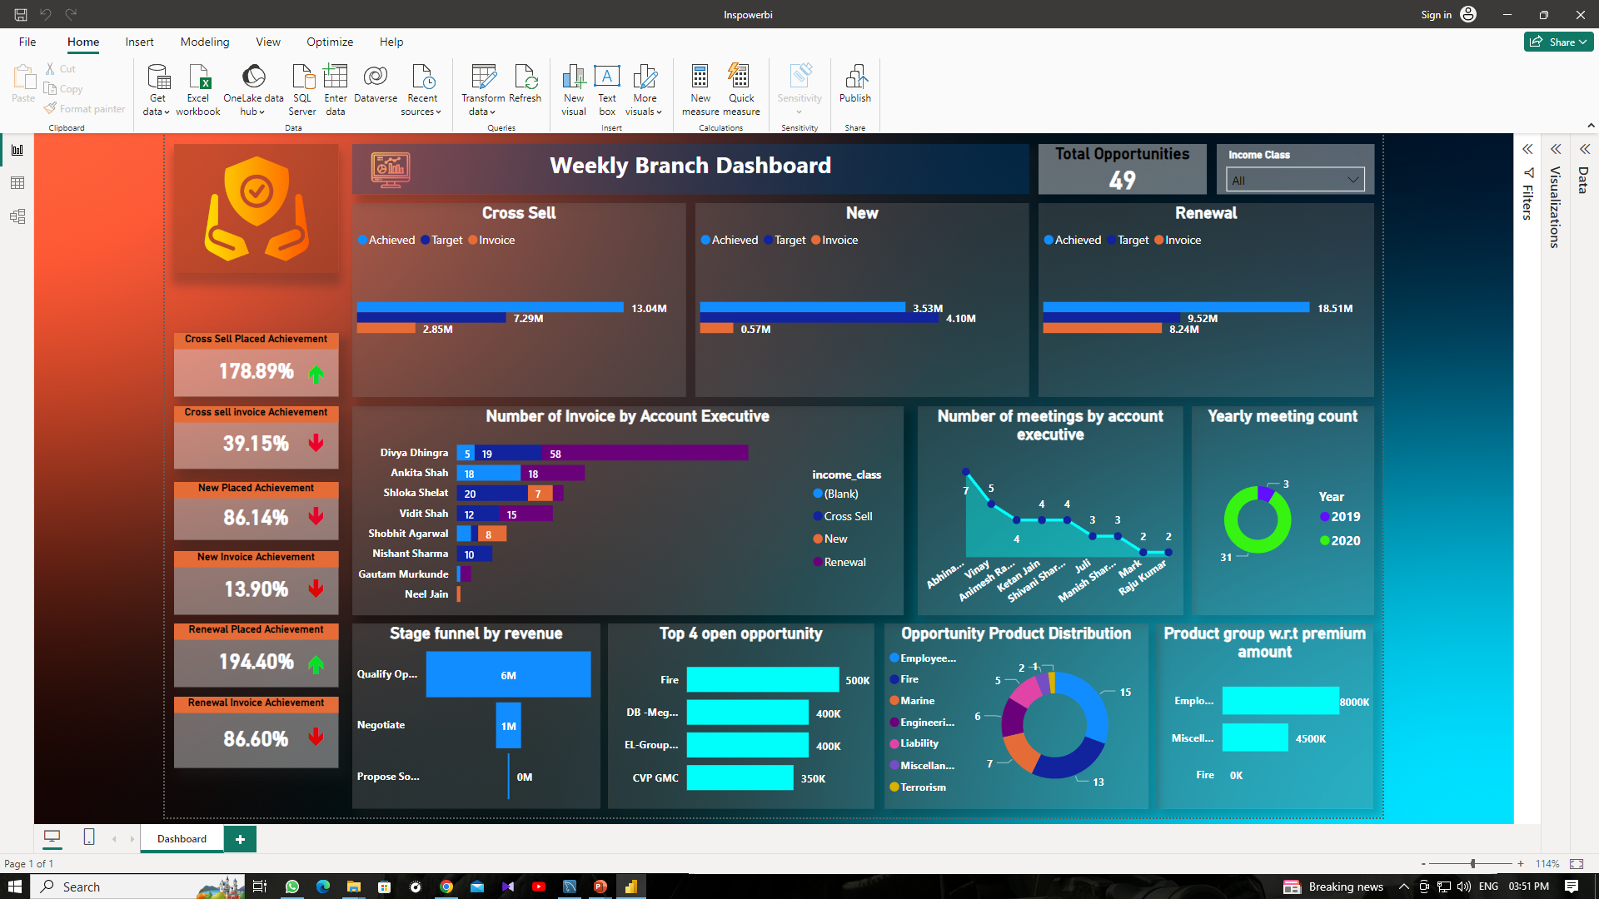
Power Bi Dashboard

Slide 8






Provide targeted training and development programs to enhance skills in areas where account executives may be underperforming. This could include sales techniques, product knowledge, and customer relationship management and Conduct a detailed analysis of each account executive's performance, considering factors like conversion rates, customer satisfaction, and revenue generated.
Divya Dhingra is a high-performing account executive with a significant number of invoices, especially in the Renewal and Cross Sell categories.
Gautam Murkunde and Neel Jain have lower numbers of invoices, suggesting a need for improvement in performance or a reassessment of their roles. Foster a collaborative environment where account executives can share best practices and learn from each other. Encourage teamwork and communication to improve overall team performance.
The "Fire" opportunity has the highest total revenue amount at $500,000, indicating that it is a significant revenue contributor.Both "EL-Group Mediclaim" and "DB - Mega Policy" opportunities share the same total revenue amount of $400,000. This suggests a level of competitiveness or similarity in terms of revenue potential. We need to review the pricing strategy for each opportunity and ensure that our pricing aligns with market expectations and provides a competitive edge also consider offering bundle deals or discounts to attract more customers.
Establish a system for regular feedback and performance reviews. Provide constructive feedback on areas that need improvement and recognize and reward successes and also identify specific strengths and weaknesses of each account executive. Understand which income classes they excel in and where they might need improvement.
Conclusions
Abhinav shivam has the highest value of meeting counts (7), suggesting he may be a leader or top performer in the context represented by these numbers. Vinay, Animesh Rawat, and Shivani Sharma have intermediate values, while Raju Kumar and Mark have lower values.Individuals with higher values, such as Abhinav Shivam, Vinay, and Shivani Sharma, may be in leadership roles or have higher levels of responsibility.
The "Qualify Opportunity" stage contributes the highest total revenue of $5,919,500, indicating that this stage is crucial in generating substantial business value. The significant revenue at the "Qualify Opportunity" stage suggests that efforts invested in qualifying and identifying potential opportunities are effective in driving revenue. Establishing performance metrics and key performance indicators (KPIs) for each stage can help in monitoring and improving the effectiveness of the sales process.

Slide 9

THANK YOU
Team Group 1
Presenter’s name-Shoubhik Paul
Email address-shoubhikpaul@ymail.com

